Slide 1
Chapter 3 - Computer Software
Application Software

Slide 2
Introduction to Application Software
Topics Covered:
  Software Categories
  Desktop vs. Mobile Software
  Installed vs. Web-Based
  Software

Slide 3
Software Categories
The four basic categories of software are:
  Commercial software – software program that is developed and sold for a profit.
  Shareware – software program that is distriguted on the honor system; typically available free for charge but may require a small registration fee.
  Freeware – software [programs, that is given away free of charge
  Public Domain software – software program that is not copyrighted.

Slide 4
Software Categories
Software that falls into any of the four categories can also be open source software—programs whose source code is available to the public.

Slide 5
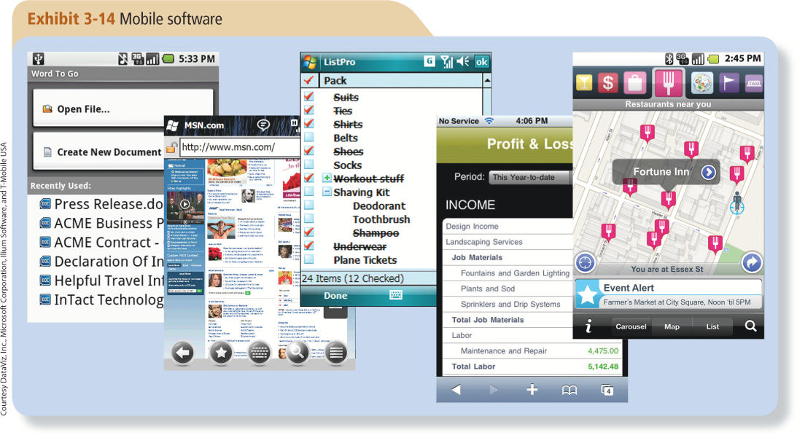
Desktop vs. Mobile Software
Mobile phones and other mobile devices usually require mobile software; that is, software designed for a specific type of mobile phone or other mobile device.

Slide 6
Installed vs. Web-Based Software
Installed software must be installed on a computer before it is run.
Web-based software is run directly from the Internet.

Slide 7
Application Software for Business
Topics Covered:
  Word Processing Concepts
  Spreadsheet Concepts
  Database Concepts
  Presentation Graphics Concepts

Slide 8
Word Processing Concepts
Word processing refers to using a computer and word processing software to create, edit, save, and print written documents.
Word processing programs typically include improved collaboration, security, and rights-management tools (tools used to protect original content from misuse by others).

Slide 9
Spreadsheet Concepts
Spreadsheet software is the type of application software used to create computerized spreadsheets.
A spreadsheet is a group of values and other data organized into rows and columns, similar to the ruled paper worksheets traditionally used by book-keepers and accountants.
Most spreadsheet programs have built-in Web capabilities.

Slide 10
Database Concepts
A database is a collection of related data that is stored on a computer and organized in a manner that enables information to be retrieved as needed.
A database management system (DBMS)—also called database software—is the type of program used to create, maintain, and organize data in a database, as well as to retrieve information from the database.

Slide 11
Presentation Graphics Concepts
A presentation graphic is an image designed to visually enhance a presentation typically to convey information more easily to people.
Electronic slide shows are created with presentation graphics software.

Slide 12
Application Software for Working with Multimedia
Topics Covered:
  Graphics Software
  Audio Capture and Editing Software
  Video Editing and DVD Authoring Software
  Media Players
  Graphics, Multimedia, and the Web

Slide 13
Graphics Software
Graphics software (also called digital imaging software) is used to create or modify images.
Painting programs traditionally create bitmap images, which are created by coloring the individual pixels in an image.
Drawing programs typically create vector graphics, which use mathematical formulas to represent image content instead of pixels.

Slide 14
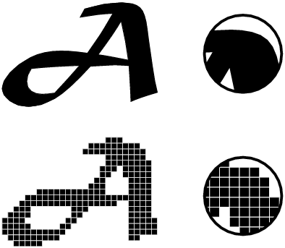
Graphics Software
Vector image
Bitmap image

Slide 15
Audio Capture and Editing Software
For creating and editing audio files, audio capture and audio editing software is used.
To capture sound from a microphone, sound recorder software is used
To capture sound from a CD, ripping software is used.

Slide 16
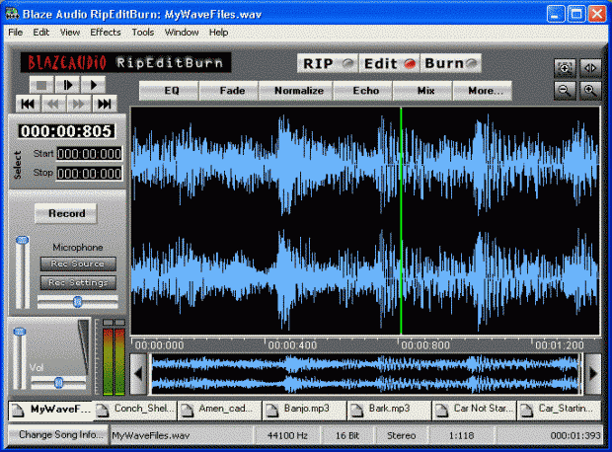
Audio Capture and Editing Software

Slide 17
Video Editing and DVD Authoring Software
Digital video can be
  imported directly into a video editing program
  Or by inserting the storage media containing the video (such as a DVD) into the computer.
DVD authoring refers to organizing content to be transferred to DVD.

Slide 18
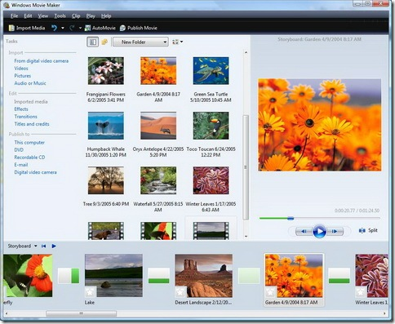
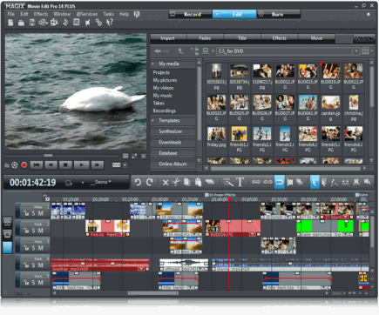
Video Editing and DVD Authoring Software

Slide 19
Media Players
Media players are programs designed to play audio and video files available via your computer—such as
  music CDs
  downloaded music
  video streamed from the Internet.
Copyright

Slide 20
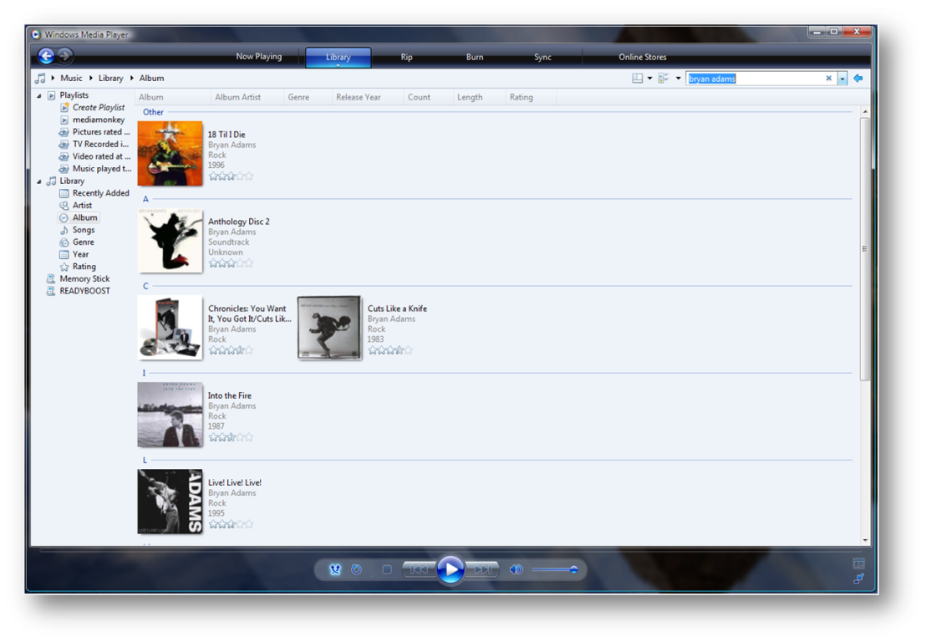
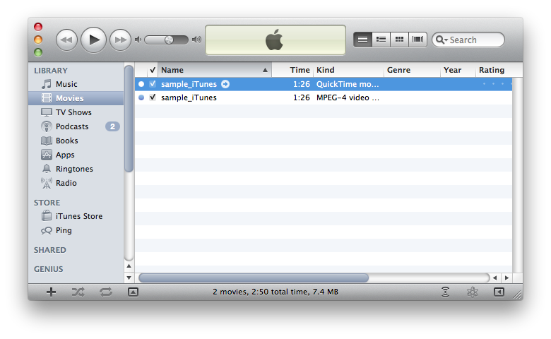
Media Players

Slide 21
Web Design Software
Software used to create web pages and web sites.
Has the capabilities of add additional content such as;
  Access to files
  Audio materials
  Video materials
  Multimedia materials.

Slide 22
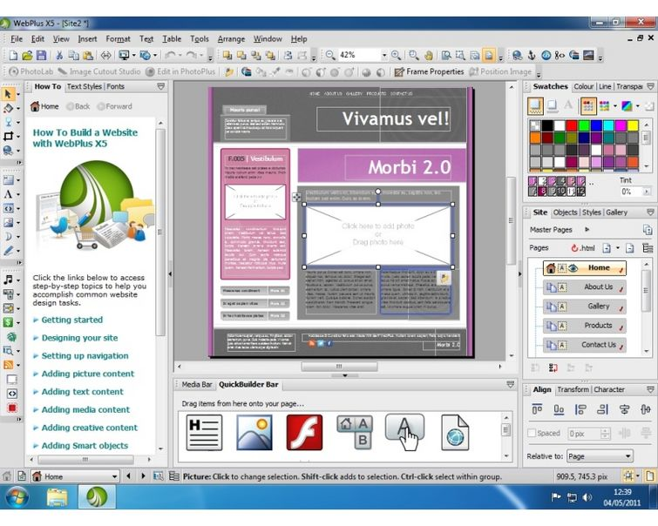
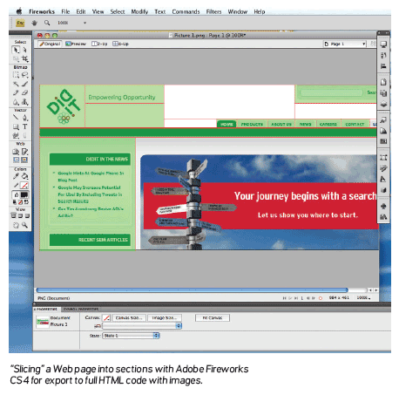
Web Design Software

Slide 23
Other Types of Application Software
Topics Covered:
  Desktop and Personal Publishing Software
  Educational, Entertainment, and Reference Software
  Note Taking Software and Web Notebooks
  CAD and Other Types of Design Software
  Accounting and Personal Finance Software
  Project Management, Collaboration, and Remote Access Software

Slide 24
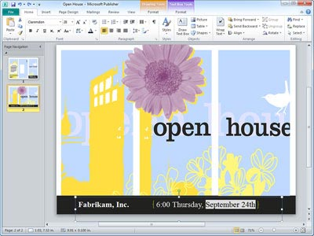
Desktop and Personal Publishing Software
Desktop publishing refers to using a personal computer to combine and manipulate text and images to create attractive documents that look as if they were created by a professional printer.

Slide 25
Educational, Entertainment, and Reference Software
Educational software is designed to teach one or more skills, or to help prepare for standardized tests.
Entertainment software includes games, simulations, and other pro- grams that provide amusement.
Reference software includes encyclopedias, dictionaries, atlases, mapping/travel programs, cookbook programs, and other software designed to provide valuable information.

Slide 26
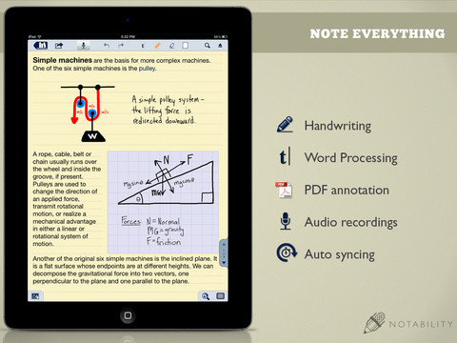
Note Taking Software and Web Notebooks
Note taking software is used by both students and business people to take notes during class lectures, meetings, and similar settings.

Slide 27
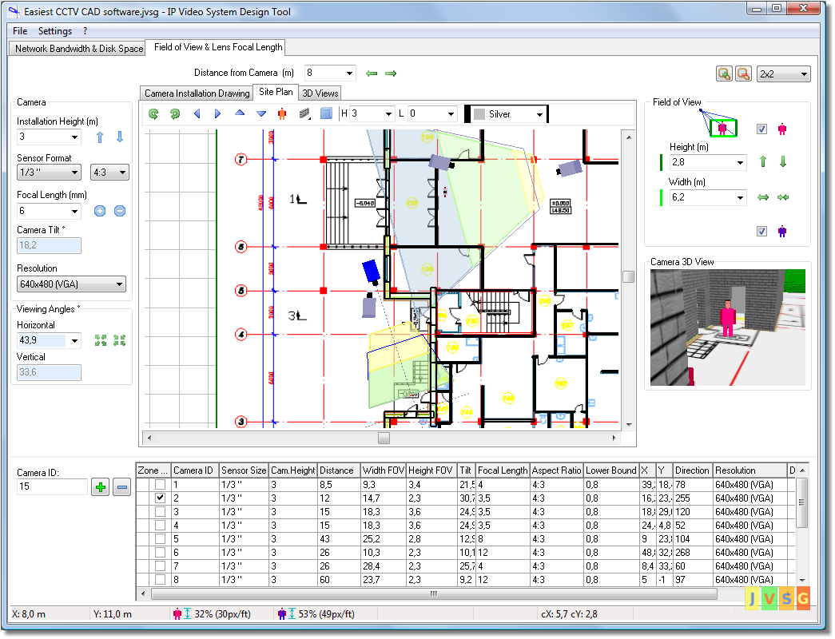
CAD and Other Types of Design Software
Computer-aided design (CAD) software enables users to design objects on the computer.
CAD is useful in fields such as art, advertising, law, architecture, and movie production.

Slide 28
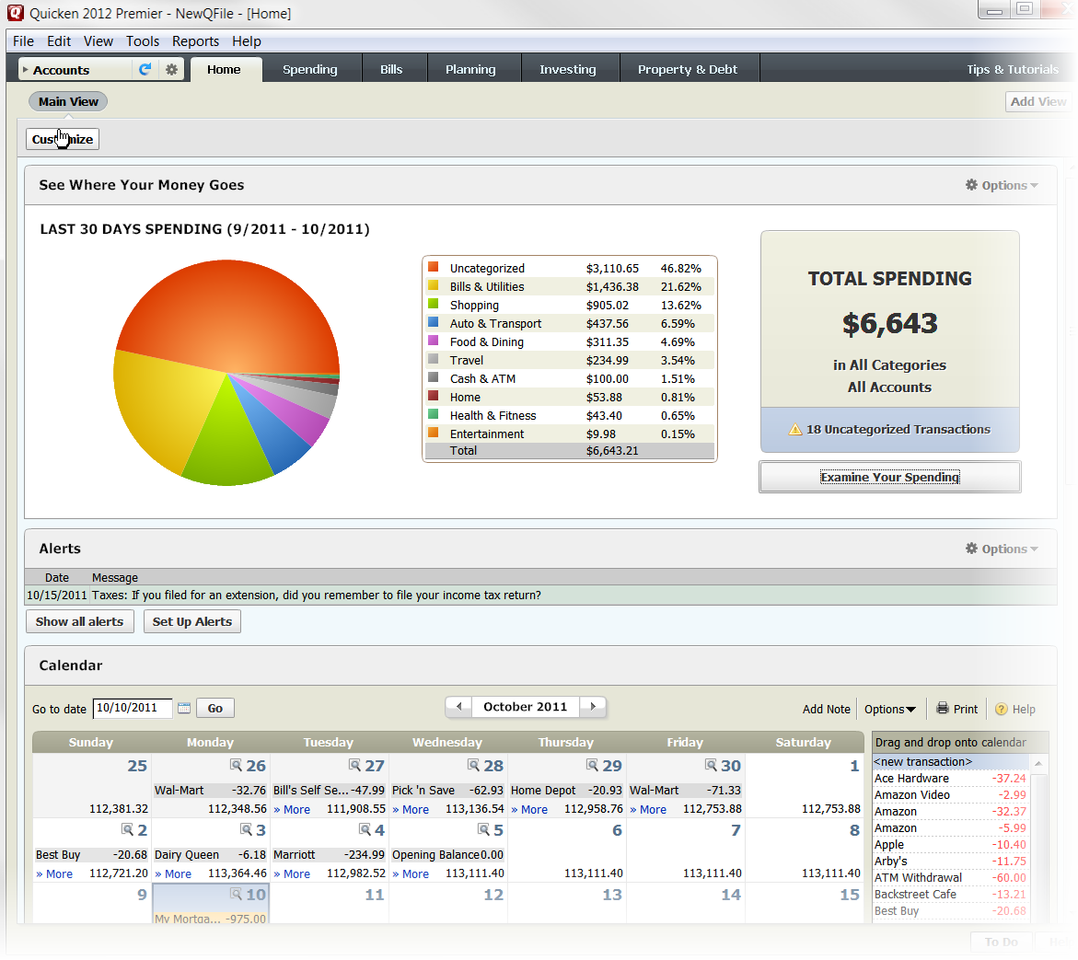
Accounting and Personal Finance Software
Accounting software is used to automate common accounting activities.
Personal finance software is commonly used at home by individuals to write checks and balance checking accounts, track personal expenses, manage stock portfolios, and prepare income taxes.

Slide 29
Project Management, Collaboration, and Remote Access Software
Project management software is used to plan, schedule, track, and analyze the tasks involved in a project.
Collaboration software—software that enables a group of individuals to work together on a project—and are increasingly available as Web-based software programs.
Remote access software enables individuals to access content on another computer they are authorized to access, via the Internet.

